Slide 1
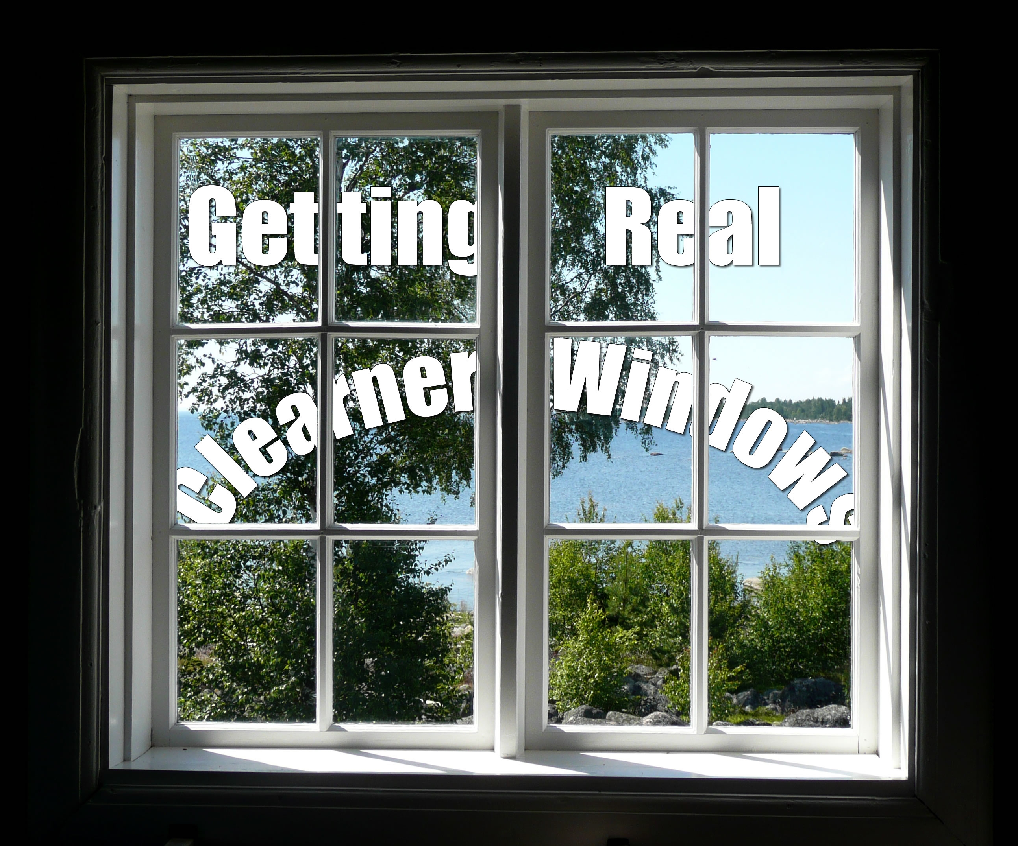
Getting Real
Mission: Cleaner Windows by
Lovely Pink Ponies Software Solutions
(Formerly JDPL Software Solutions)
Notes:
Jonas
Introduction:
Team
Donato
Loan
Pedro
Jonas
This is our Getting Real Project, codename Cleaner Windows
Using an Agile working method
Started out with TDD, but kind of fell off somewhere along the road when databases got involved.

Slide 2

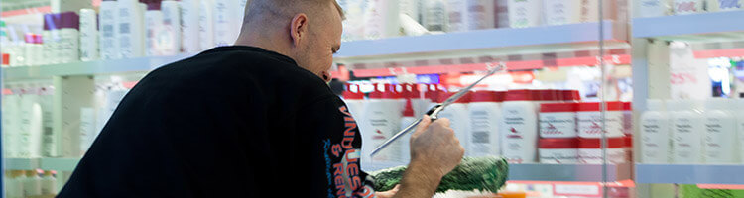
Our Company
CR Vinduespolering & Rengøring
Founded 1998 – took off in '09
28 Employees (inc. Office Staff)
24h service across Syddanmark
Notes:
Jonas
Nice small medium company
Fast growing
Talked a co-partner for contact
Really nice

Slide 3
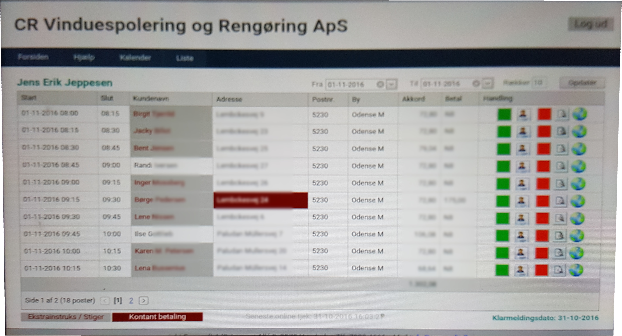
What we are doing for them
Reworking Existing System
Customer and Schedule Management
Notes:
Donato
Existing system – already knew what they wanted and potential for improvement
Server runs off computer in office
Web interface – badly scaled to tablets

Slide 4

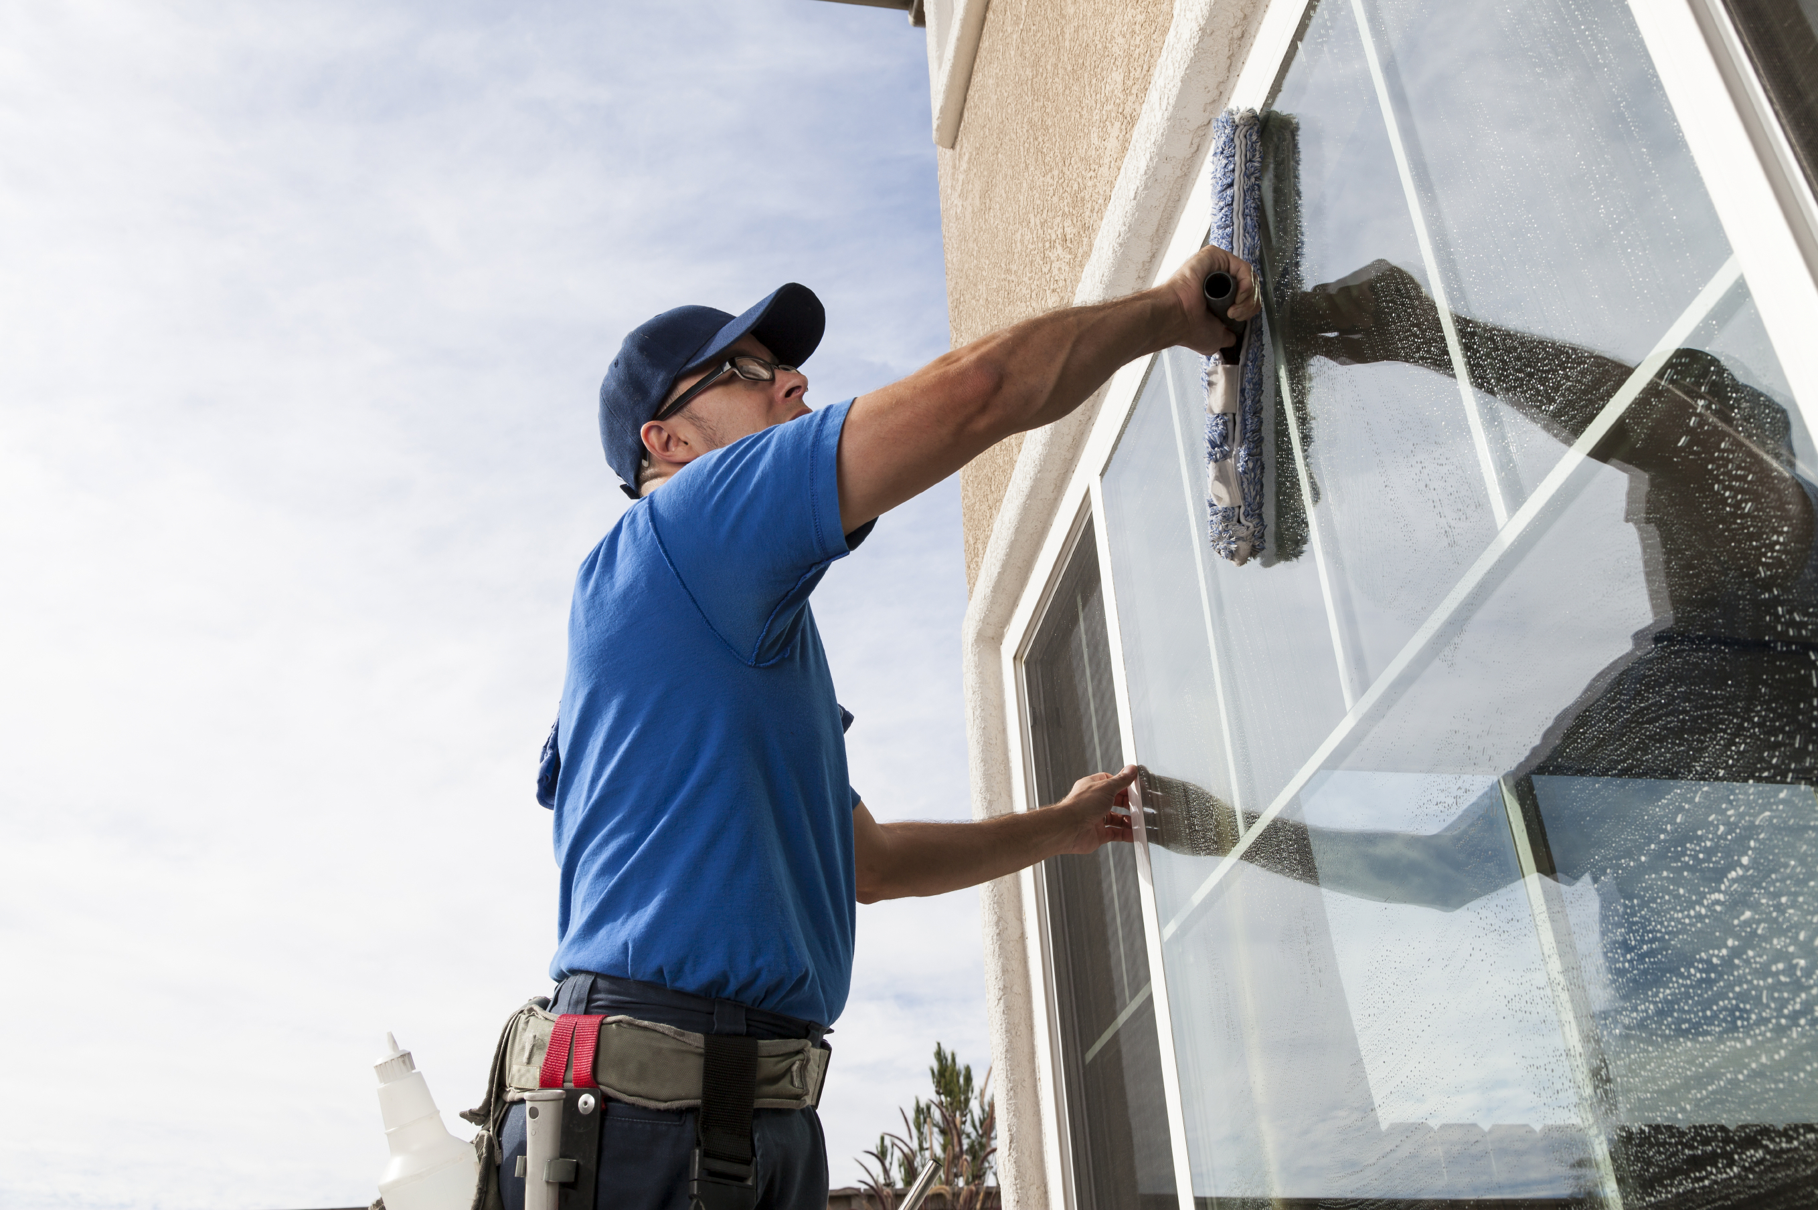
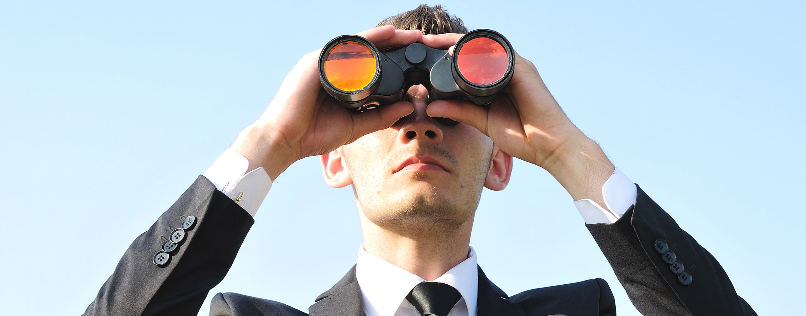
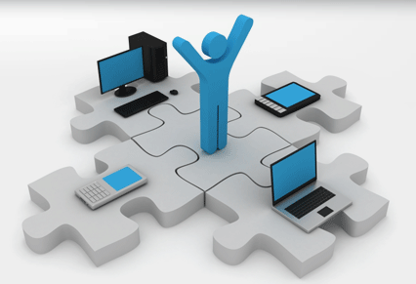
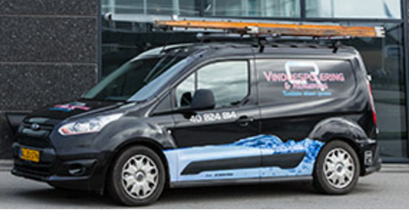

Key resources
Employees
Market Knowledge
IT System
Vehicles
Equipment
Notes:
Donato
The main resources of our company are: Employees, Market Knowledge, Vehicles, Equipment and IT System. We are handling the employees thought the IT System, but it's pivotal for each of the other key resources as it branches out.

Slide 5

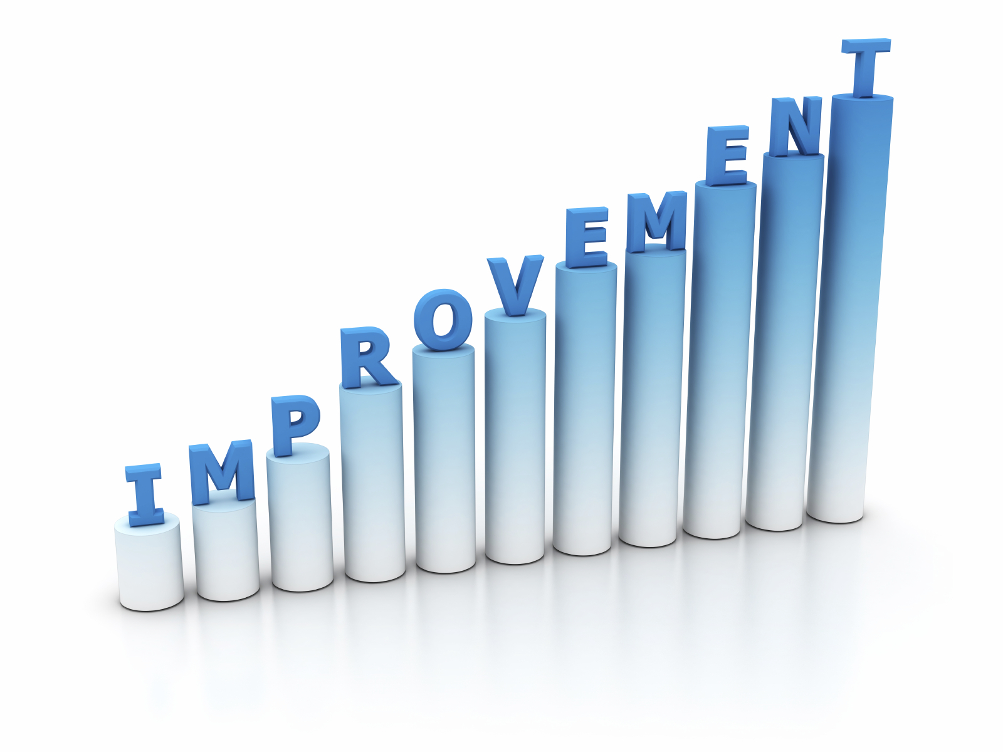
KPI
Customer's Satisfactions
Service Hours Per Day, Per Month
Time For Creating Task
Notes:
Loan
Customer's Satisfactions: Make Surveys about Customer's Satisfaction with the old IT Subscription Service and the new IT application, with satisfactions index ranking from 1 to 10. Compare the two indexes to see if there are any improvements
Service Hours Per Day, Per Month: Record the total number of service hours per day, per month with the old IT Subscription Service and the new IT application to compare the two total service hours to see if there are any improvements
Time for Creating Task: make a "time for creating task" survey among the company employee with indexes (more slowly, no change, faster, much faster)to measure changes, improvement between the old and new IT System

Slide 6
Class Diagram, SSD, SD
Agile
Meeting with business owner
Business Model and business analysis
Domain Model, Object Model
User Stories, Roles and Scenario
Feedback
Implement the code

Slide 7

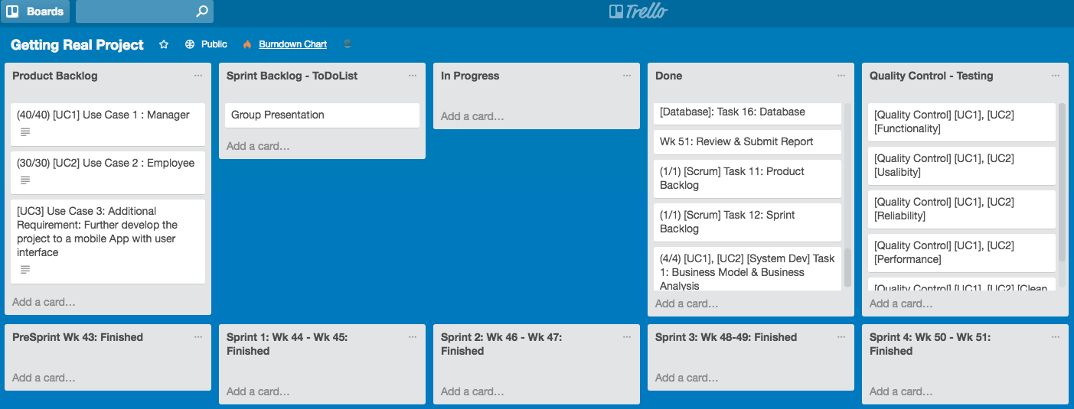
Notes:
Loan

Slide 8
Prioritized requirements
F U R P S +
Usability Human factor
Leveling requirements
Notes:
Jonas
- Model for classifying software quality attributes
- Human factor; the system should be built to work perfectly for low knowledge users and be easily understandable for anyone.
We tried to leveling the requirements in order to develop the system in a equally way in all requirements needed.
Legal: Hosted under MIT license

Slide 9
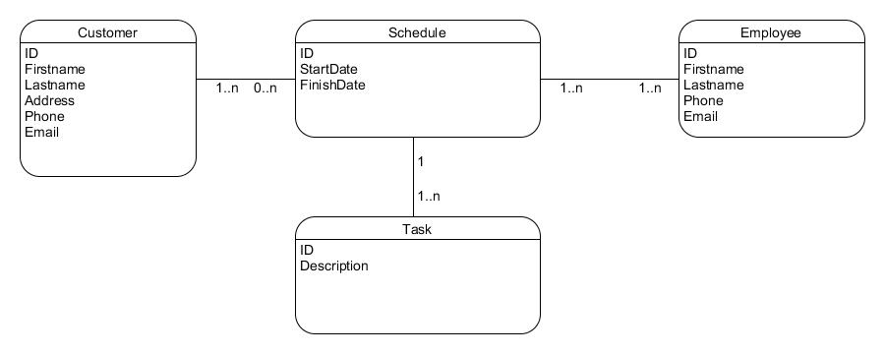
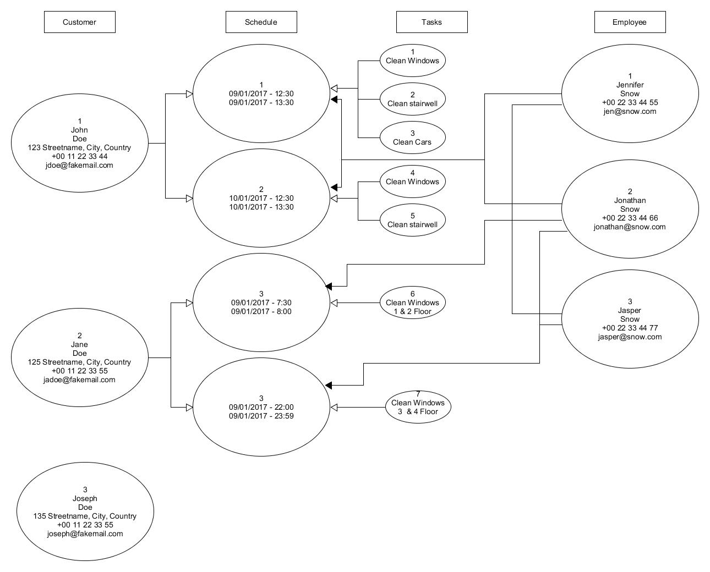
Domain Model
Notes:
Pedro
Explain how we moved from centring around customer to centring about schedule

Slide 10
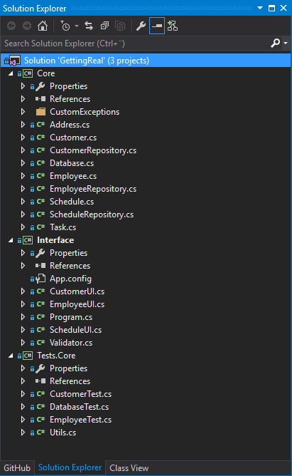
Code Architecture SOLID
Notes:
Pedro
Really proud of our separation
Interface is completely replaceable
Separate Database functions
SOLID (single responsibility, open-closed, Liskov substitution, interface segregation and dependency inversion)

Slide 11
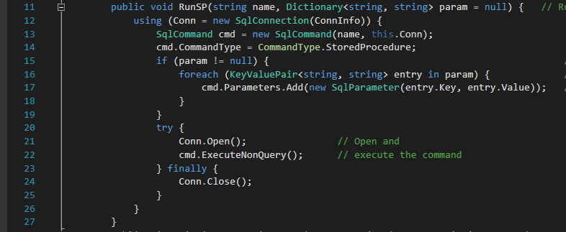
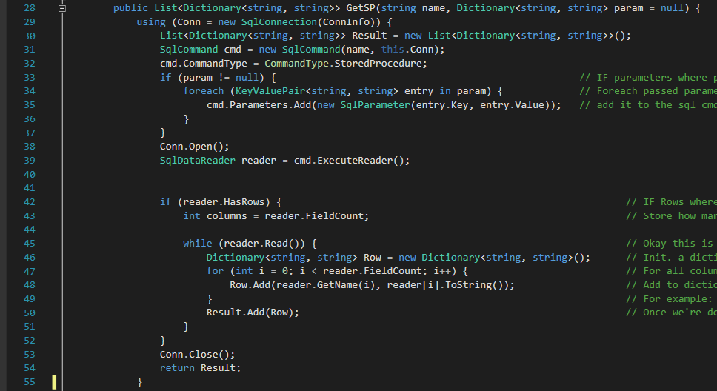
Code Examples
Notes:
Donato
How Solid was implemented by these class
Database Interface
All our database queries run though these 2 methods. RunSP works with stored procedures which does not have a return, while GetSP works with procedures that do have a return.
Database could be (should be) an interface implementation (thinking back in retro-spective)
As working with databases is often a pain, we wanted to streamline this process as much as possible.
The return of GetSP is a List of Dictionaries, with each iteration in the list being a touple (row).
The following dictionary then contains information in that touple (row), in the form of <attribute>, <value>
For example, a SP like SELECT ID, Firstname FROM Users could return something like:
List<
Dictionary<
ID, 1
Firstname, John
>
Dictionary <
ID, 2
Firstname, Jane
>
>

Slide 12
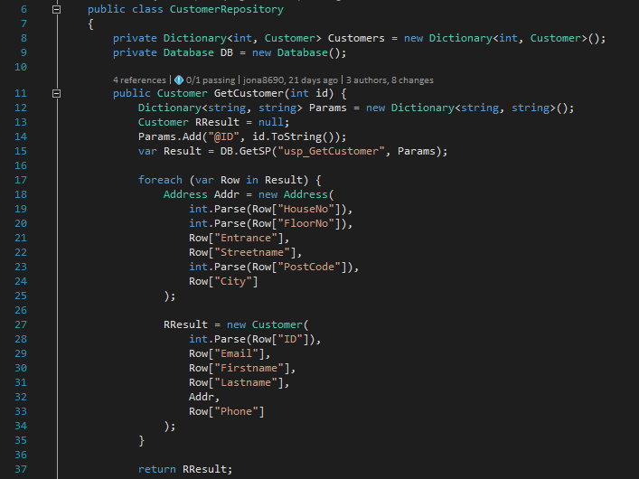
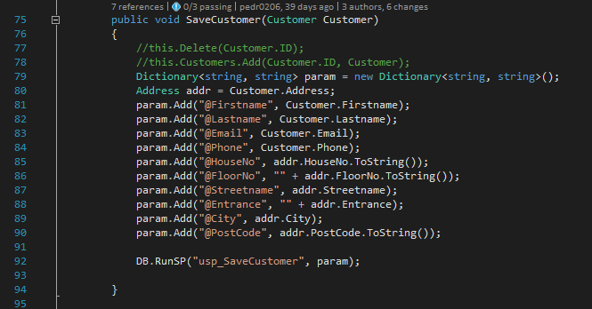
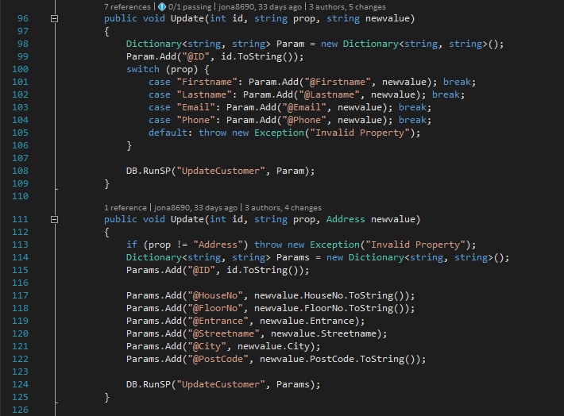
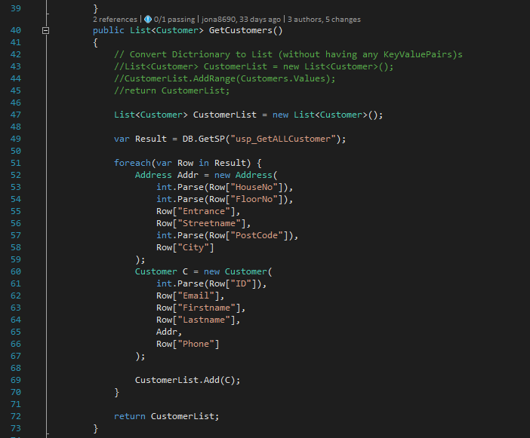
Code Examples Customer & Employee Repo
Notes:
Loan
Main difference, employee repo has login methods
Could also be implementation of an interface, but decided against since the two classes should never be mixed/confused.

Slide 13

What we have learnt from this Project ?
Cooperate well with the Product Owner
Agile Development "rocks"
Artifacts and Codes is a heavenly - made couple
Teamwork is King

Slide 14
GETTING REAL GROUP 1 L.P.P S.S.
CSRMC MANAGEMENT
Thank You!

